Slide 1
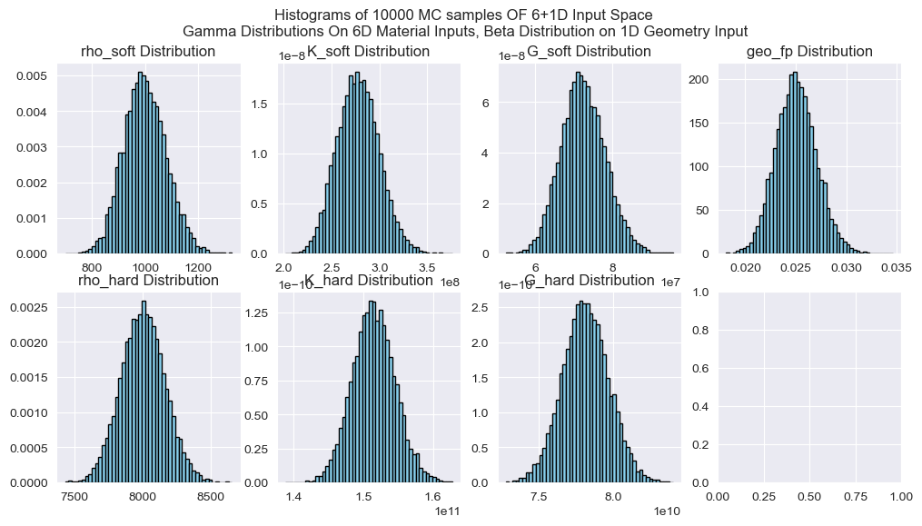
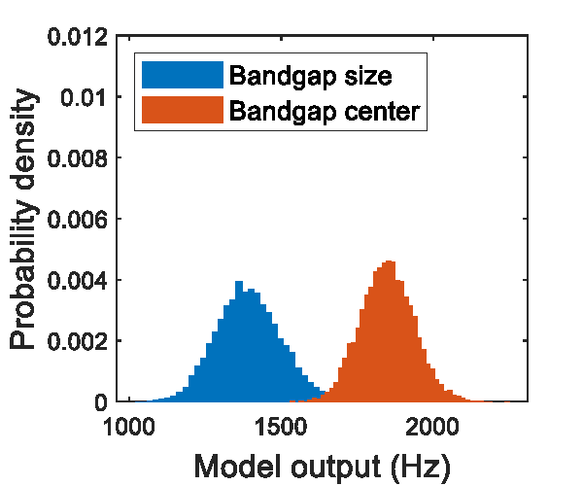
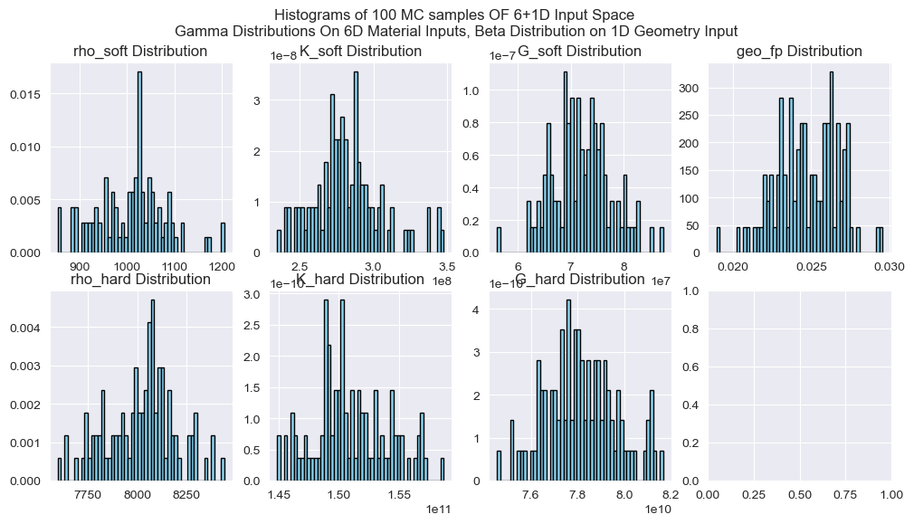
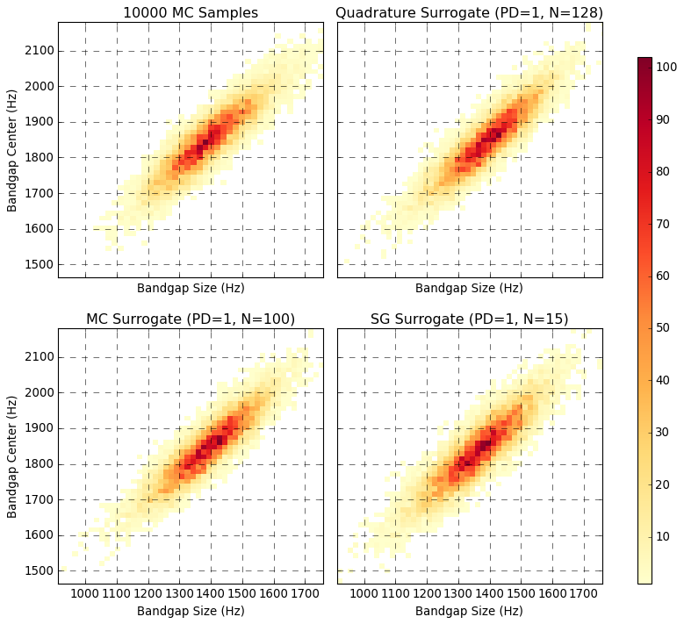
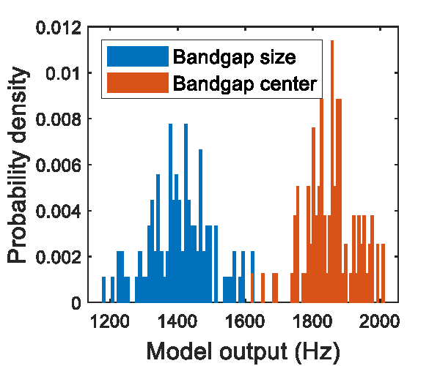
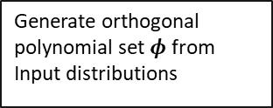


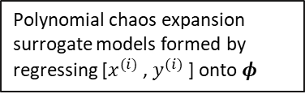
Uncertainty Quantification of Bandgaps in Acoustic Metamaterials with
Stochastic Geometric Defects and Material Properties
Input Space (7D)
Sampling Strategies
Reserved Monte Carlo Samples
Geometry with stochastic defects
Monte Carlo (MC)
Quadrature Rule (QR)
Sparse Grid (SG)
Generate orthogonal polynomial set $φ$ from Input distributions
6 stochastic material properties
Surrogate Model Results
x6 (similar distributions at different scales)
Sample inputs $x^{(i)}$
Finite element analysis
Polynomial chaos expansion surrogate models formed by regressing [$x^{(i)}$, $y^{(i)}$] onto $φ$
Output Space (2D)
Metamaterial bandgap size and location
Sample Outputs $y^{(i)}$

